Slide 1
IMPAACT Laboratory Center Interactive Laboratory Activation Checklist
Ceora Beijer, BS
Project Manager
26 September 2024

Slide 2
What is the Laboratory Activation Checklist (LAC)?
A document to aid in tracking the progress of the selected laboratories that will support a site for the study.
Outlines all the requirements that must be completed prior to receiving laboratory approval for a study.

Slide 3
What is the Purpose of the LAC?
The LAC:
ensures all laboratory assays will be performed in a compliant setting and all laboratory infrastructure is established to support the proposed study
allows for a clear and comprehensive list of outstanding requirements between the site, laboratory, and LC representatives
ensures adherence set out by ICH, FDA, EMA, and DAIDS
is a DAIDS required document to be filed within the electronic Trial Master File (eTMF)

Slide 4
Laboratory Activation Initiation
The protocol-specific Laboratory Specialist(s) will initiate the Laboratory Activation process with a Welcome Email and the release of the Domestic Analyte List (DAL)/Protocol Analyte List (PAL).
The Welcome Email will:
Provide an introduction of the Laboratory Specialist(s) for the study
Outline the requirements for receiving Laboratory Activation
Include a blank LAC, for reference
Template Specimen Flowchart (for Non-US/International Sites only)
The LAC will be sent to the Site/Labs periodically during initiation until the completion of laboratory activation.
Site/Labs can request an updated LAC at any time from their study-specific Laboratory Specialist

Slide 5
US (Domestic) LAC

Slide 6
US (Domestic) LAC Requirements
The Site/Labs are responsible for:
1. Completion of the Domestic Analyte List (DAL)
2. Current documentation for each testing laboratory, for the duration of the study:
CAP accreditation (or equivalent)
CLIA certification (or equivalent)
* All documentation should be submitted via the MiLab Central Database (www.milabcentral.org)
3. Completion of the Laboratory Attestation, via DocuSign

Slide 7
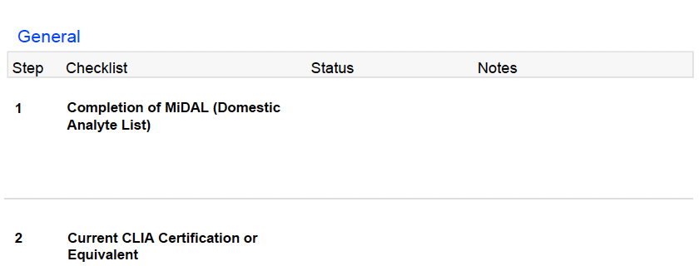
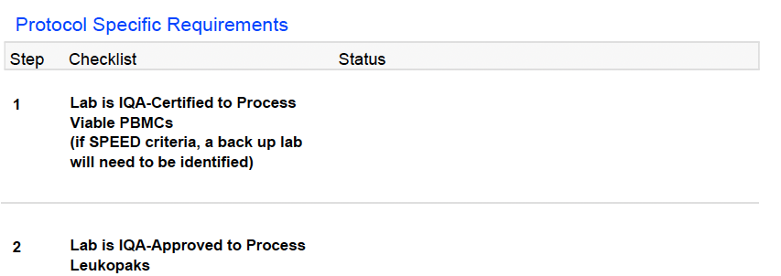
US (Domestic) LAC Template
To be presented in further detail by Sara Zabih
Completed through the MiLab Central Database (www.milabcentral.org)
These documents can be uploaded while completing the DAL or uploaded to the MiLab Central Database (www.milabcentral.org) to the Supporting Documents section.
If required, must have a successful current score
Associated Routine Testing Laboratories listed on the Domestic Analyte List
If required, lab must be IQA-approved.
If not required, field will be indicated as N/A
Notes:
Status of the LAC Item will indicate if it has been completed or incomplete.
Fields that are not required for the protocol (i.e Leukopaks) will be indicated as N/A

Slide 8
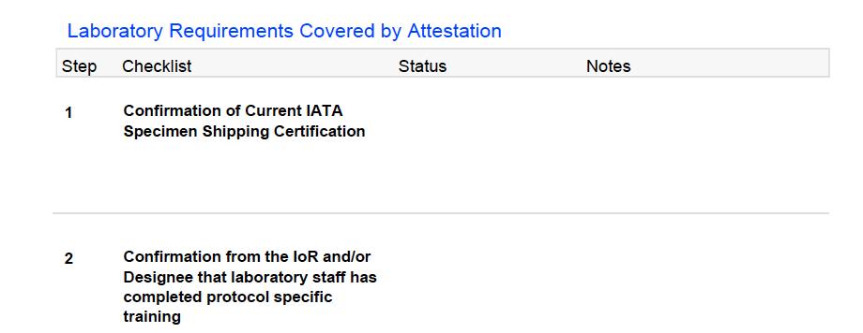
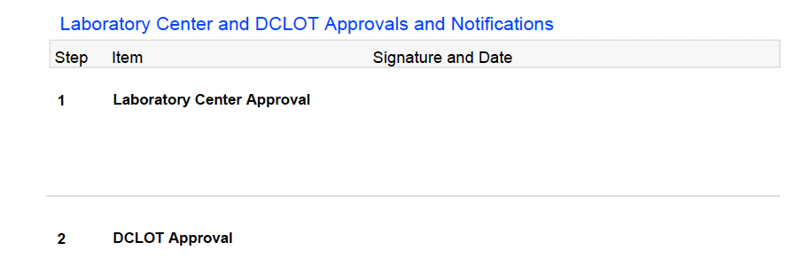
US (Domestic) LAC Template
Laboratory Attestation will be sent, via DocuSign for IoR/designee completion
Once all LAC items have been completed, the LC specialist will sign the checklist and submit to DCLOT for their approval and signature
Notes:
Point out the new attestation items

Slide 9
US (Domestic) LAC Completion
Once all items are completed, the Lab Specialist will sign the LAC and send to DCLOT for approval/signature.
The Lab Specialist will notify that the site/labs of the laboratory activation, via email, which will include the finalized DAL, DCLOT-signed LAC, and lab approval letter.

Slide 10
Non-US (International) LAC

Slide 11
Non-US (International) LAC Requirements
The Site/Labs are responsible for:
1. Completion of the Protocol Analyte List (PAL) and associated documents
2. Successful proficiency testing scores for the applicable laboratory(ies)
3. Closed Action Plans (AP) and Investigation Reports (IR)
4. Uploading current Supporting Documentation (CV and SOP Index)
*All documentation should be submitted via the MiLab Central Database (www.milabcentral.org)
5. Completion of the Laboratory Attestation, via DocuSign

Slide 12
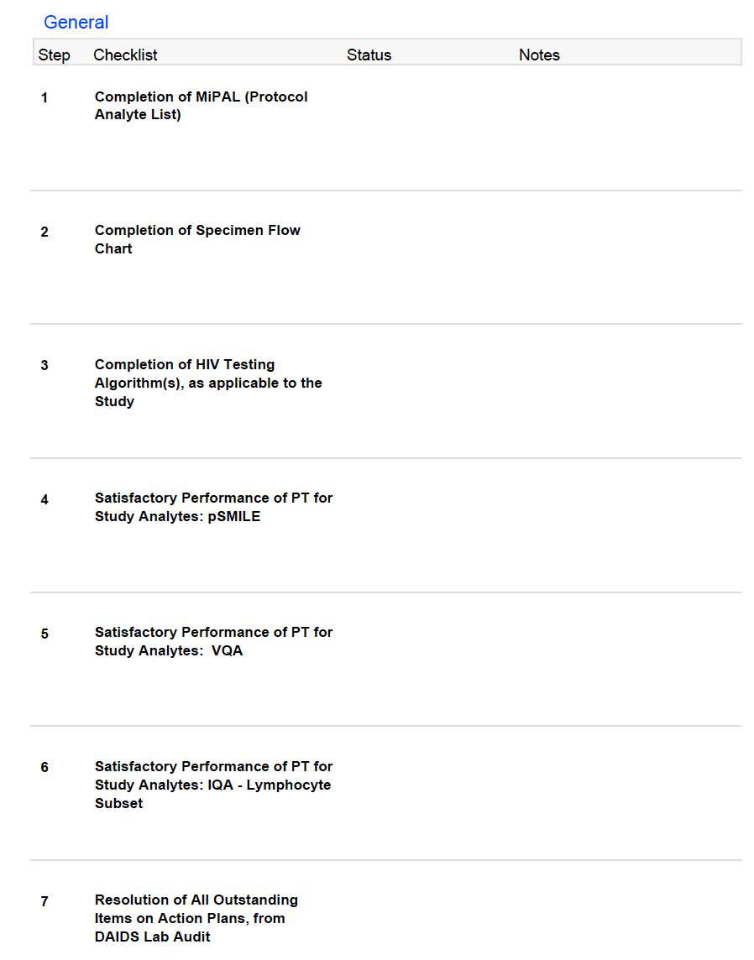
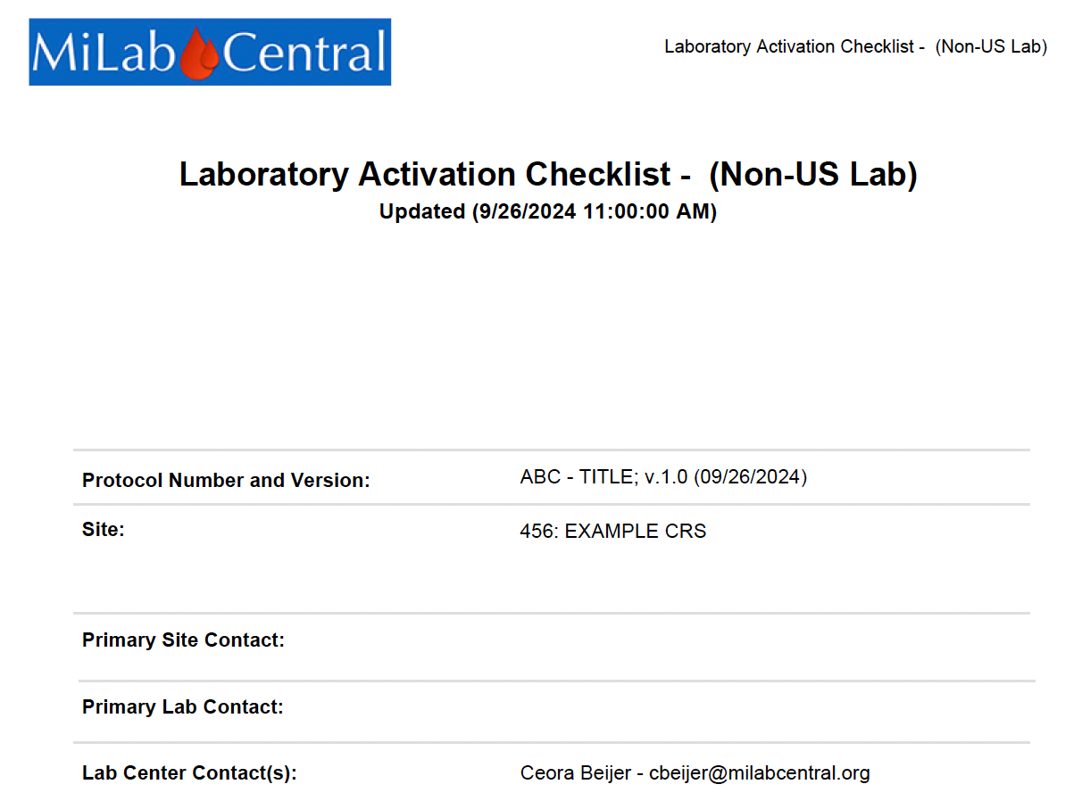
Non-US (International) LAC
To be presented in further detail by Sara Zabih
To be presented in further detail by Helty Adisetiyo
To be presented in further detail by Diane Costello
Successful 2 out of 3 most recent PT scores (> 80)
Successful 2 out of 3 most recent PT score

Slide 13
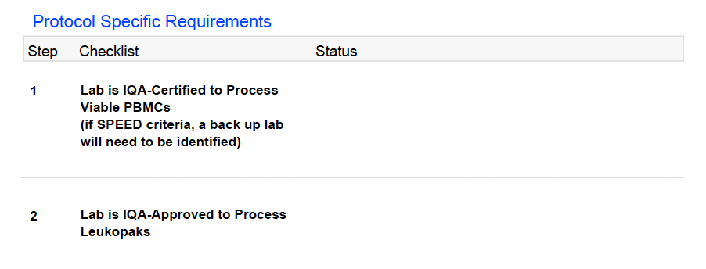
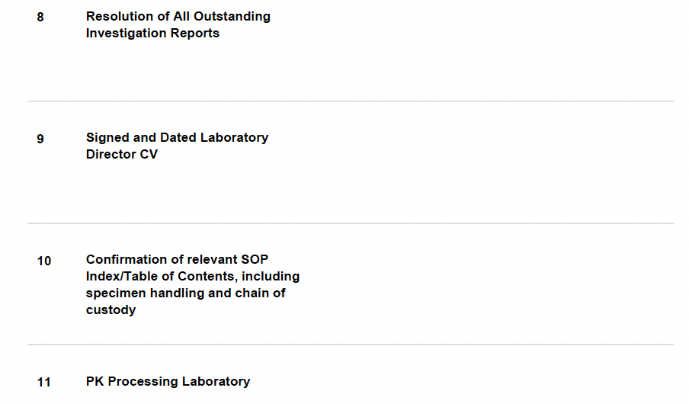
Non-US (International) LAC
Successful 2 out of 3 most recent PT score
If required, must have a successful current score
All Action Plans and Investigation Reports must be closed, prior to submitting for lab approval. *APs and IRs open for < 30 days will not delay lab activation.
Fields that are not required will be indicated as N/A
Laboratory Attestation will be sent, via DocuSign for IoR/designee completion
Documents should be uploaded to the MiLab Central Database (www.milabcentral.org) under the lab’s supporting documents section
Should be indicated on the Specimen Flowchart
Notes:
Fields that are not required for the protocol (i.e Leukopaks) will be indicated as N/A

Slide 14
Non-US (International) LAC Template
Laboratory Attestation will be sent, via DocuSign for IoR/designee completion
Once all LAC items have been completed, the LC specialist will sign the checklist and submit to DCLOT for their approval and signature
Notes:
Two new attestation Items (#7 and #8)

Slide 15
Non-US (International) LAC Completion
Once all items are completed, the Lab Specialist will sign the LAC and send to DCLOT for approval/signature.
The Lab Specialist will notify that the site/labs of the laboratory activation, via email, which will include the finalized PAL, PAL-associated documents, DCLOT-signed LAC, DocuSigned laboratory attestation, and lab approval letter.

Slide 16
Suggestions for Expedited Completion of the MiPALs
Address the MiPAL queries in their entirety as soon as possible.
Ensure the HIV Algorithms, Specimen Flow Chart are reviewed in their entirety as most delays are caused by preventable errors, including:
Copy/Paste HIV Algorithms and Flow Charts from other studies with different requirements.
Missing details of instruments and methods
Each revision made on the PAL requires the LC representative to review all laboratory components (i.e. EQA/IR/AP status, PAL associated docs, etc..)
LC Website: https://actg-impaact-lc.org
Notes:
PAL query confusing? Reach out to the LC

Slide 17
Suggestions for Expedited Completion of the MiPALs
Ensure the site and laboratory are in communication while completing the MiPAL entries for point of care testing
i.e. Pregnancy and HIV testing
Submit validation documents for new instruments/methods as soon as possible to the LC Validations Team/IQA/VQA providers.
The laboratory is responsible for updating the inventory within the MiLab Central Database.
Monitor EQA status and have a back-up plan in place. Communicate with site labs and LC in times of shortages/failures to increase testing options.
The LC is not responsible for granting exceptions/waivers to the laboratories with performance deficiencies but can aid in finding other options.
LC Website: https://actg-impaact-lc.org
Notes:
If you need to enroll in proficiency testing – reach out the LC and we will make the request on your behalf.
Backup trouble? LC can often aid in finding a solution

Slide 18
Suggestions for Expedited Completion of the LAC
Close the Action Plans and Investigation Reports within the sponsor required timelines.
Failure to complete these items will delay lab activation.
Ensure all the Supporting Documents (CAP/CLIA or equivalent (Domestic labs only), SOP Index and signed and dated Laboratory Director CV) are current and uploaded to the MiLab Central Database.
Laboratory Attestation items (IATA, PK Training tutorials, Reference Ranges…) do not need to be uploaded to the Supporting Documents Section
LC Website: https://actg-impaact-lc.org

Slide 19
Questions & Helpful Resources
IMPAACT Lab Center Website (https://actg-impaact-lc.org)
Resource Tab: Helpful Documents and Training Videos
FAQ Tab: MiLab Central Database, PAL/DAL, Validations, Document Upload Questions…
IMPAACT Lab Center Listserv (impaact.qaqc@fstrf.org)
Notes:
Put website on each slide.

Slide 20
Thank you for your continued efforts and support!

