Slide 1
Laboratory Center Interactive
26 September 2024

Slide 2
AGENDA
PALs & DALs – Sara
HIV Algorithms – Diane
Specimen Flow Charts – Helty
Validation Submissions - Will
Activation Checklists (US and International Labs) – Ceora

Slide 3
Laboratory Center Interactive –
HIV Algorithms
Diane Costello, BS
IMPAACT LC Project Manager
26 September 2024

Slide 4
The Basics
HIV Algorithms:
are required for studies which include testing for documentation of HIV status to be done, and that testing is part of the protocol (i.e., results are not obtained from medical records)
accompany MiPAL submission along with Specimen Flow Charts
are reviewed and approved by the Laboratory Center (LC) Specialist [NIAID] or Westat Laboratory Specialist [NICHD] on the study and DAIDS Clinical Laboratory Oversight Team (DCLOT) prior to lab-specific study activation
can be requested by monitors during an audit (this includes LC audits!)

Slide 5
The Basics, cont’d
IMPAACT protocols have standard language for this HIV testing – generally found in Section 4 Study Population, which includes eligibility criteria, specifically Inclusion Criteria
For studies that include determination of HIV status as part of the protocol eligibility criteria, test results meeting protocol requirements must be available for final eligibility determination prior to enrollment of each study participant, unless otherwise specified by the protocol.
Sites/labs must specify HIV testing algorithms for each IMPAACT study consistent with protocol specifications

Slide 6
The Basics, cont’d
Two broad categories of testing: for those ≥ 2 years of age and those < 2 years of age
Attention must be paid to participant age and feeding methods. For potential participants < two years of age, or who have recently breastfed, maternal HIV status must be considered as well. When maternal antibodies may affect test results, nucleic acid testing (NAT) will be specified as required
For studies that include both participants living with HIV and those not living with HIV, further specifications for determining HIV status are typically described in an additional sub-section of protocol Section 4

Slide 7
Participants ≥ 2 yrs and no breastmilk exposure in the past 28 days
Sample #1
Sample #2
Two rapid antibody-based tests from different manufacturers or based on different principles and epitopes (combination antigen-antibody-based rapid tests may be used).
One enzyme immunoassay (EIA) or Western blot (WB) or immunofluorescence assay or chemiluminescence assay
One HIV DNA PCR
One quantitative HIV RNA PCR (above the limit of detection of the assay)
One qualitative HIV RNA PCR
One HIV total nucleic acid test
Rapid antibody-based test. If this option is used in combination with two rapid tests for Sample #1, at least one of the three rapid tests must be FDA-approved and the third rapid test must be from a third manufacturer or based on a third principle or epitope. Combination antigen-antibody based rapid tests may be used.
One enzyme immunoassay (EIA) or Western blot (WB) or immunofluorescence assay or chemiluminescence assay
One HIV DNA PCR
One quantitative HIV RNA PCR (above the limit of detection of the assay)
One qualitative HIV RNA PCR
One HIV total nucleic acid test

Slide 8
Participants < 2 yrs or ≥ 2 yrs with any breastmilk exposure in the past 28 days
Sample #1
Sample #2
One HIV DNA PCR
One quantitative HIV RNA PCR (above the limit of detection of the assay)
One qualitative HIV RNA PCR
One HIV total nucleic acid test
*If the participant or the participant’s mother is receiving antiretroviral drugs, an HIV DNA assay may be more sensitive
Nucleic acid testing methods required because maternal antibodies may affect test results if mothers are living with HIV.
One HIV DNA PCR
One quantitative HIV RNA PCR (above the limit of detection of the assay)
One qualitative HIV RNA PCR
One HIV total nucleic acid test
*If the participant or the participant’s mother is receiving antiretroviral drugs, an HIV DNA assay may be more sensitive
Nucleic acid testing methods required because maternal antibodies may affect test results if mothers are living with HIV.

Slide 9
Points to Remember
All study-specific samples tested to determine HIV-1 status must be whole blood, serum, or plasma.
  DBS samples are not allowed for this testing on IMPAACT studies due to the decreased assay sensitivity
All testing methods should be USA FDA-approved, if available.
  If available in-country, the FDA-approved method must be used even if more expensive
On demand nucleic acid-based methods may be acceptable for use in site testing algorithms for either Sample #1 or Sample #2
  i.e., Cepheid GeneXpert HIV-1 VL assay may be used by international sites

Slide 10
HIV Testing Schemes cont’d
For potential participants initially presumed by study staff to be living without HIV based on available medical history information and /or participant/guardian report, Teams may consider requiring only one rapid test (rather than two). HIV testing would be performed in the study site’s designated testing lab during the study screening period per Sample #1 requirements.
Note - use of two rapid tests is preferred for diagnostic purposes and is often required as standard of care at many sites.
In 2019 - responding to changing epidemiology, WHO recommended countries adopt a standard HIV testing strategy with 3 consecutive reactive tests for an HIV-positive diagnosis and phase out older testing technologies, including Western Blot.

Slide 11
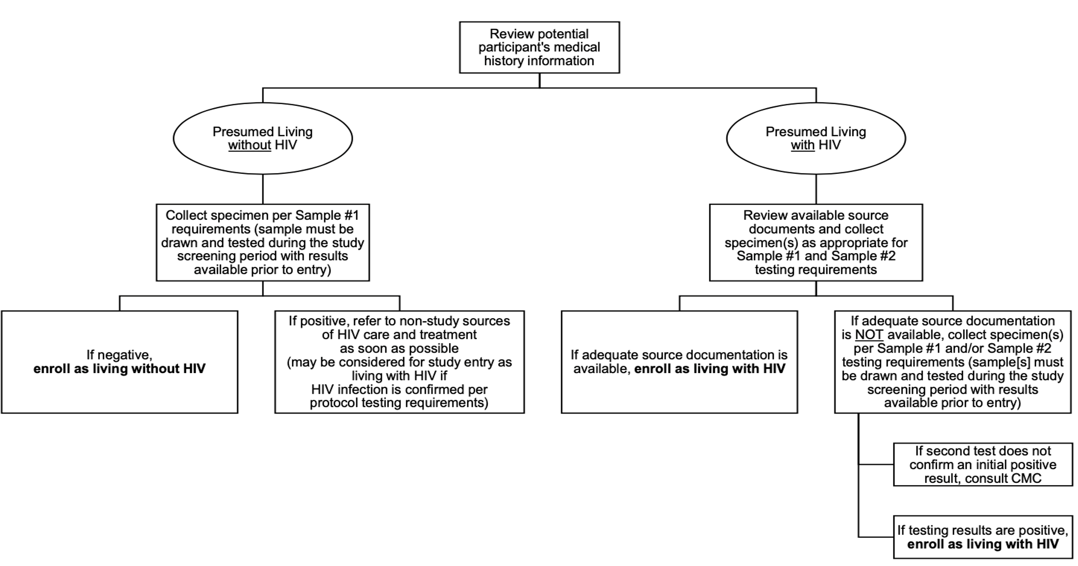
IMPAACT Guidance Document: Template Protocol Language for Determination of HIV Status version 3.0, dated 10Nov 2021

Slide 12
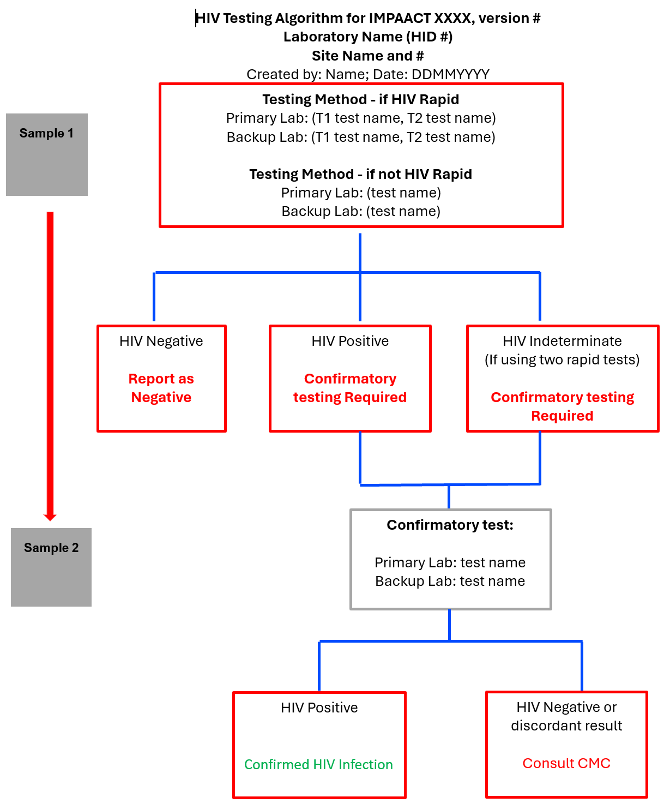
Example - HIV Testing Algorithm: Participants ≥ 2 yrs and no breastmilk exposure in the past 28 days or a Maternal Algorithm

Slide 13
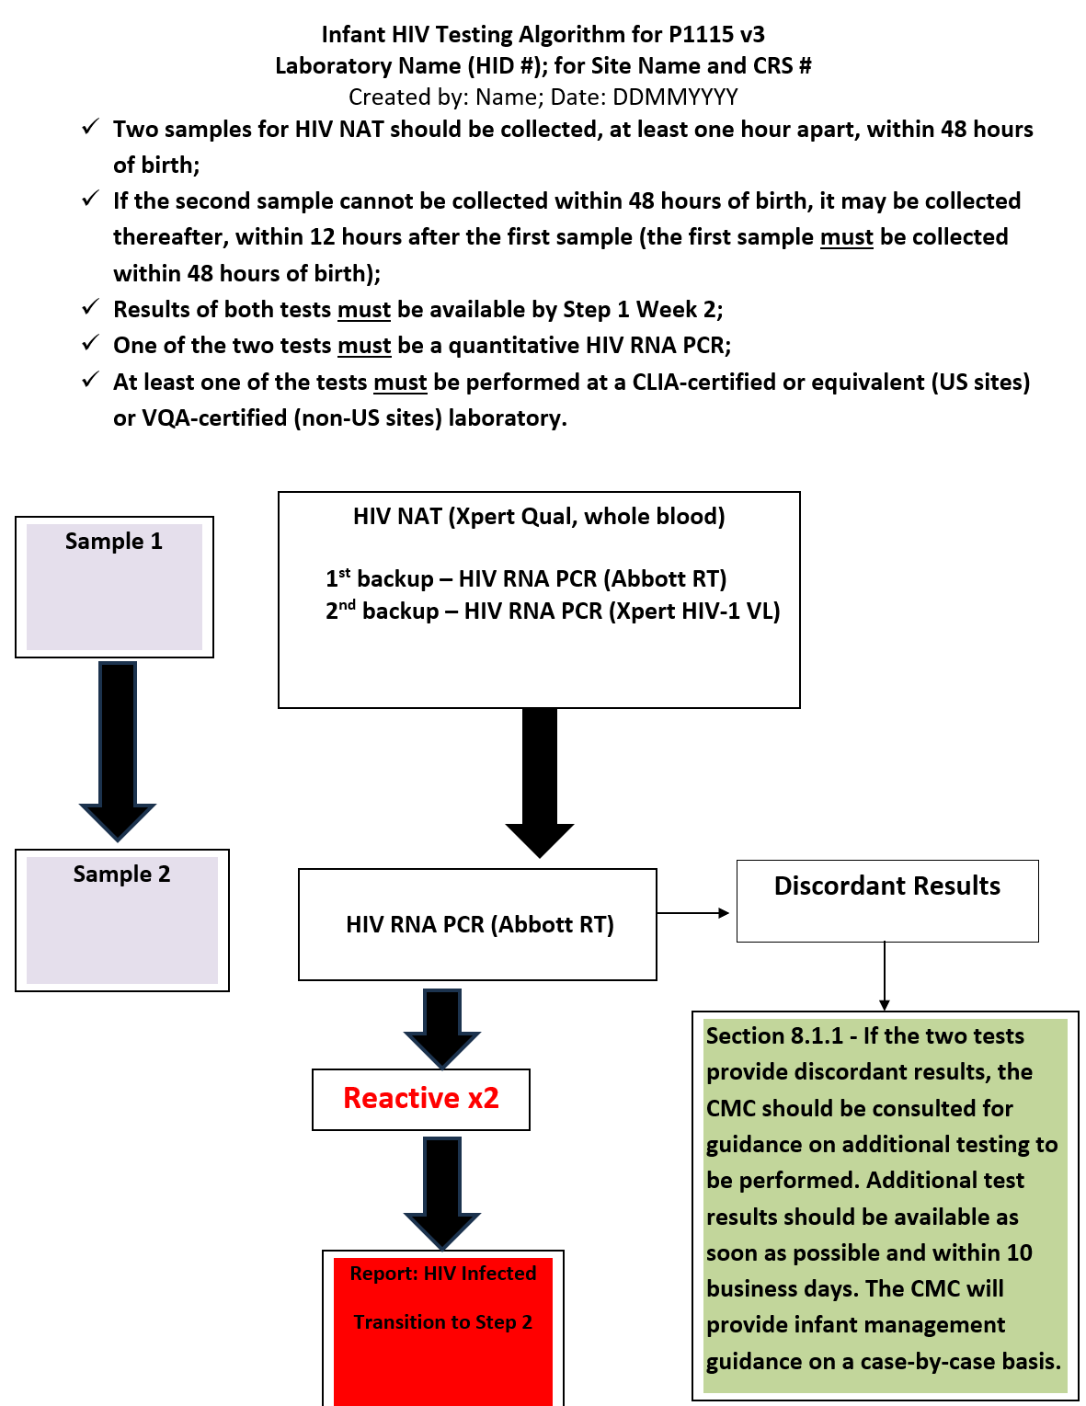
Example – HIV Testing Algorithm

Slide 14

THANKS!
Any questions?
You can find me at dcostello@milabcentral.org

